Slide 1
Update 1
Dev Bhatia
Boston University
Ultrafast Optics Laboratory

Slide 2
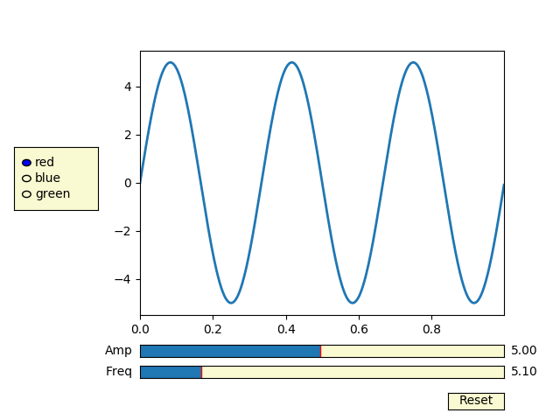
Simulation Updates
Adding a comprehensive graphical user interface in order to speed up data acquisition
User would be able to alter experimental parameters directly from the generated plot without having to alter the script
Git Integration
Quality of life improvements (i.e. version control, delocalization, etc.)

Slide 3
Paper Analysis – Temperature Modulation
A linear mediation property exists between the absorption driven temperature rise and the IR exposures [3]
However, this would only exist to an extent given our IR parameters
The averaged absorption driven temperature rise could be affecting the sodium channel functions (i.e. action potential) [3]
This is indicative of certain biophysical parameters being altered by the increased heat in the saline solution, the question being which ones

Slide 4
Paper Analysis – Temperature Modulation
It was shown that membrane resistance and axoplasmatic resistance may both decrease when illuminated [1]
Incorporating this degradation may lead to more accurate results in the simulation

Slide 5
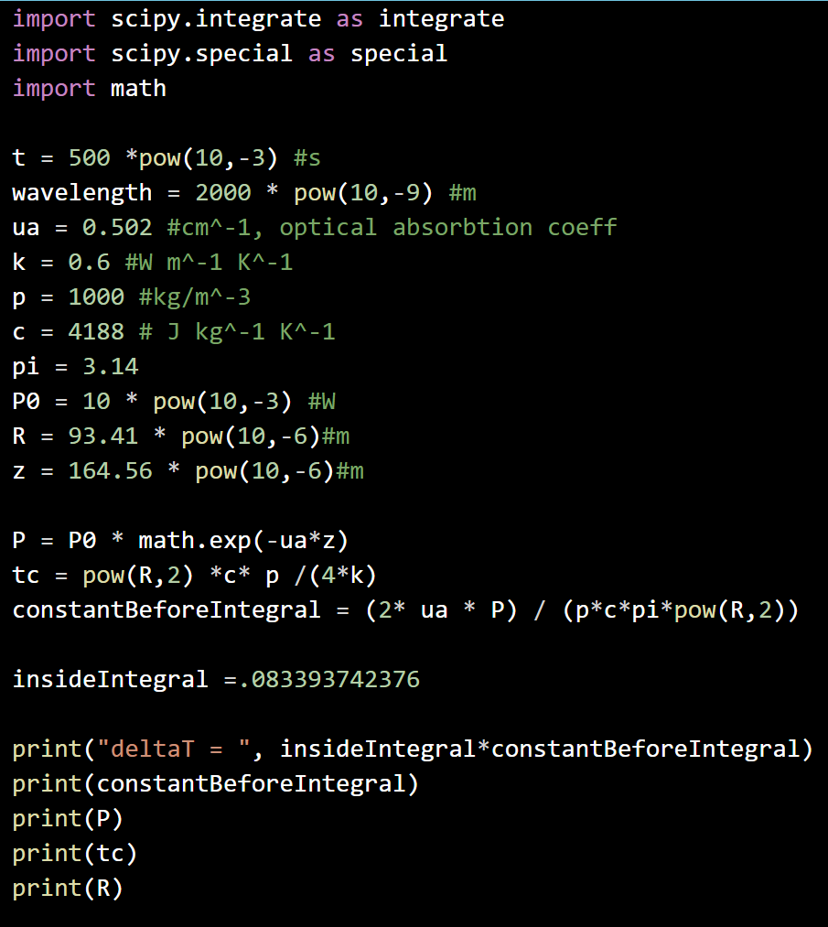
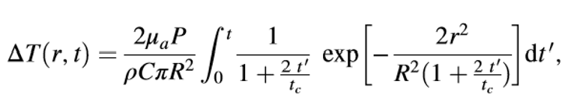
Temperature Simulation
Absorption Driven Temperature Rise [3]

Slide 6
Next Steps
Investigate which biophysical parameters can be altered by Infrared-induced temperature changes, modeling resistance fluctuations in particular
Incorporate the above in the NEURON simulation and optimize
Continue developing the temperature model, incorporating cohesive integration functions

Slide 7
Sources
[1] Zhu, Xuedong, Jen-Wei Lin, and Michelle Y Sander. "Infrared Inhibition and Waveform Modulation of Action Potentials in the Crayfish Motor Axon." Biomedical Optics Express 10, no. 12 (2019): 6580-6594.
[2] Yao, Jing, Beiying Liu, and Feng Qin. "Rapid Temperature Jump by Infrared Diode Laser Irradiation for Patch-Clamp Studies." Biophysical Journal 96, no. 9 (2009): 3611-619.
[3] Li, Xinyu, Jia Liu, Shanshan Liang, and Changsen Sun. "980-nm Infrared Laser Modulation of Sodium Channel Kinetics in a Neuron Cell Linearly Mediated by Photothermal Effect." Journal of Biomedical Optics 19, no. 10 (2014): 105002-105002.

